Slide 1
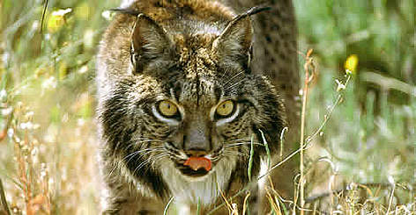
IBERIAN LYNX
By:Hana

Slide 2
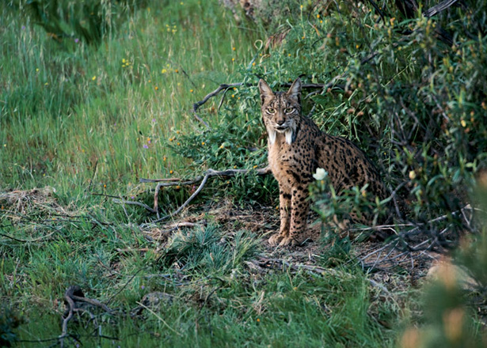
Habitat:
The Iberian lynx is found in open forests, marquis thicket, sand dune and woodland settings. They frequently take up residence in areas that have ample scrub vegetation, as well. The Iberian lynx tends to stay away from plantations for Pire and eucalyptus trees.

Slide 3
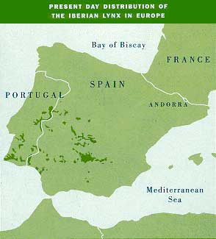
What country/continent is the lynx located?
The Iberian lynx natural habitat is open forests and sand dune in isolated areas of Spain and Portugal. It is an endangered species with only 1,000 remaining in the wild.

Slide 4
What caused this animal to be endangered?
Car hits: The construction of high speed roads and highways, is one of the main threats for this wild cat. The year 2014 was a black year. About 22 animals died under the wheels of cars.
Habitat loss and degradation: Roads, dams, railways and other human activities contribute to the loss of the Iberian lynx distribution area. It is thought that between 1960 and 1990, the Iberian lynx suffered an 80% loss in its range.
Illegal hunting: Hunters prized its valuable fur and its meat. The Iberian lynx was legally protected against hunting from the early 1970’s but they are still the victims of guns, traps, and snares, particularly set for other animals.
Climate change: Under future climate change conditions, it is unclear if the regions where the lynx currently lives will still be suitable for the species. The lynx range to the north, could improve to its climate change.

Slide 5
Are there laws protecting the Iberian lynx?
Yes, the WWF is protecting the lynx. The WWF has been working to protect the Iberian lynx for more than 15 years. This law uses high tech cameras, which helps the WWF conservationists to better understand and protect the lynx.
The Big Cat Rescue law is also protecting the Iberian lynx.

Slide 6
What could people do to save this animal?
There are many organizations protecting this animal. You can help contribute to the organization as well to help save the Iberian lynx.
We can also protect the Iberian lynx’s habitat by planting a cork tree.

Slide 7
Interesting facts:
The scientific name for this animal is called lynx pardinus.
An Iberian lynx can spot a mouse 250 feet away
Their life span in the wild is 14 years
The male Iberian lynxes are much larger than the female ones
Lynxes are the most active after sunset and before sunrise.

Slide 8
bibliography
http://www.my-cause.com/
http://wwf.panda.org/
http://bigcatrescue.org/
http://www.interestingfunfacts.com/

